Slide 1

Systemic Racism and U.S. Health Care
Pre-Health Research Journal Club
Disclaimer:
The following presentation may outline sensitive topics. All information that will be discussed is directly from the research sources and we will refrain from including our personal views. Any of the following content provided from our sources is not to malign any race, ethnic group, political party, community, socioeconomic background, and any individual in general.

Slide 2





FOUNDERS/MENTORS
Natalya
Krutovska
Deepshikha
Kewlani
Mahnoor Memon
Zaina
Syed
Alia Isabekova

Slide 3


Step 1
CHOOSING
A
JOURNAL ARTICLE

Slide 4

How to choose a journal article?
Find an article on a topic you’re interested in or you want to learn more about
Make sure you are using a reliable source to find your article.
How do I know if my source is reliable?

Slide 5


Finding a Reliable Source
Hunter College Library
https://library.hunter.cuny.edu/
Using the Hunter College Library gives students access to a variety of credible, reliable databases.
Click on databases when you get to the Hunter College Library Website
How do I know which database to use?

Slide 6
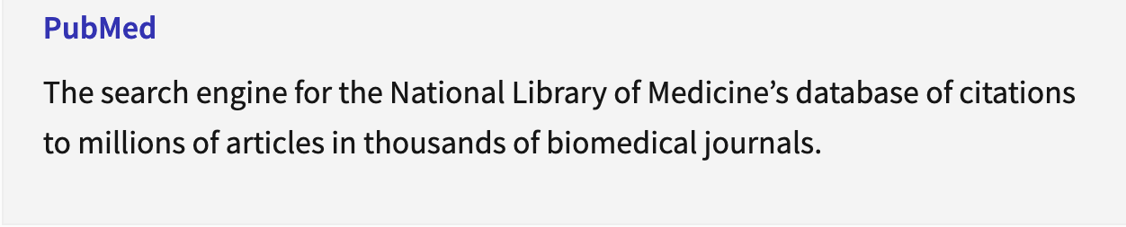



Common Databases Used for Research Articles
Pubmed
Google Scholar
Web of Science

Slide 7
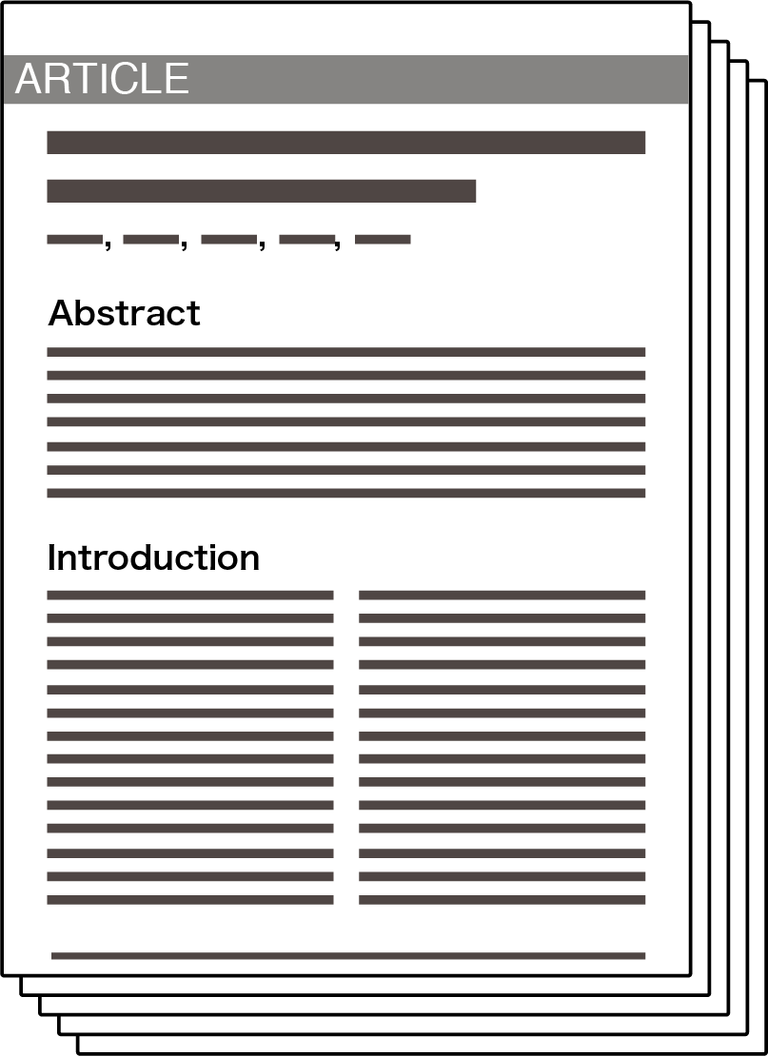
Once you’ve found an article…
Make sure it's been published recently.
The article shouldn’t be older than 4-5 years.
Make sure the article is not a draft.
Question to yourself, why is this a good article to present on?
Make sure it interests you!

Slide 8

After you’ve done that, you’re ready to start planning your presentation!

Slide 9
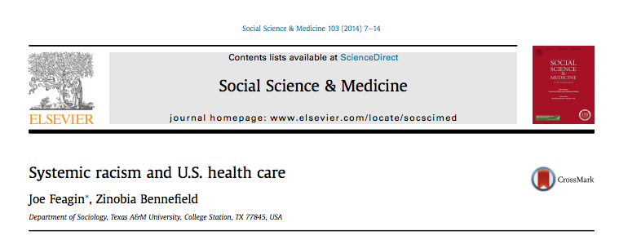
Why did we choose this article?

Slide 10
Systemic Racism and U.S Healthcare
This article discusses the U.S public health problem that stems from systemic racism and its negative effects on the lives of Americans of color.
Definition of Systemic Racism
BIPOC
Historical Context of Systemic Racism

Slide 11

Aims of the Paper
Focus on two to four main points of the paper
Aim - what the authors of the article are trying to present to the audience
General research findings
Background information
Experiments and research methods that have led to the discoveries
Abstract, introduction, and headings are a good indicator of general ideas

Slide 12
Specific Aims
Systemic Racism Theory
Dominant racial hierarchy
Comprehensive white racial framing
Individual and collective discrimination
Social reproduction of racial-material inequalities
Racist institutions integral to white domination of Americans of color
Institutionalized white socioeconomic resources, discrimination, and racialized framing from centuries of slavery, segregation, and contemporary oppression severely limit health care access and health care outcomes for Americans of color
In order to work through the racial disparities in healthcare, there needs to be a model that truly assesses racist roots and current racism realities

Slide 13


Methods
Biomedical Sciences
In vitro tests
Mathematical/Computer studies
Human epidemiological studies
Clinical trials
Social Sciences
Surveys
Interviews
Focus groups
Experiments

Slide 14

Results
Focus on specific findings that the author wants to portray in the article
In comparison to the aims that are more general, this is the portion of the presentation that you will spend explaining the main part of the article.
Focus on the content under the headings for your main source of results
Graphs/Data analysis
Statistical significance

Slide 15
Powerful White Actors and Racial Framing
Roles, framing, and institutionalized actions of influential decision makers
Responsibility of powerful individuals for health-related problems
Public health researchers and policymakers
Medical educators and officials
Hospital administrators
Insurance and pharmaceutical executives
¾ of those practicing medicine are white
Rather than “bias”, “prejudice” and “cultural competence”, systemic racism and white racial framing are better terms to indicate society’s racist realities
Notions like stereotypes of biologically and culturally distinct racial groups inherently promotes discriminatory practices that account for institutionalized inequalities

Slide 16

The Structural Approach: An Important Research Shift
Individual acts are such a tiny snapshot of the larger institutional racism picture
Health care providers care for individuals
Part of a shared white racial frame
A high socioeconomic status allows for access to superior resources for better health, while low status denies availability to these resources
Racially advantaged identities of the privileged whites who control allocations of resources
“Race is central to every aspect of the new science and technology that is emerging from genomic research”

Slide 17
Important Historical Background: Persisting Systemic Racism
19th century - scientific medical systems driven by profit pressed white physicians to discover treatments and technology
In the South, experiments were carried out on black women that no white physician would try on whites
Death of many enslaved women and continued use of African Americans as tests for medical progress
Past abusive experimentation and malpractice sets tone for discriminatory treatment in present time
First half of 20th century - involuntary sterilization and hysterectomies of black women
Early 20th century - Eugenics
1932 - “Study of Syphilis in the Untreated Male”

Slide 18
Further Analysis of Text
Differential Racial Treatments Today: Healthcare Providers
Main Takeaway:
Health inequalities do not result from something inherent in Americans of color, but are health consequences of systemic racisms pathway of negative impact.
Research Study:
In a study, actors portrayed black and white patients with coronary disease symptoms; 720 physicians were asked to look at these recorded interviews and other patient data, assess the probability of disease and suggest treatment.
Black patients were less likely to be recommended for standard catheterization, compared to whites with similar occupations and medical histories.
Overall: Black patients are less likely to receive the best surgical treatment that white patients would otherwise, have access to.
Reason proposed by researchers: “Subconscious Bias” and “Financial Disincentives”

Slide 19
Further Analysis of Text
Differential Racial Treatments Today: Healthcare Providers
Research Study:
Another study found physicians with 50% + black and hispanic patients differ greatly in treatments of patients compared to physicians with 50%+ white patients.
Physicians with more patients of color often failed to recommend best treatments and seemed to be highly influences by a racial framing of health behaviours of patients of color.
Clinics that had more patients of color were less likely to recommend mammography screening, influenza immunization for older patients, and smoking cessation programs.
Medical Research Scandal:
1940s- heavy use of people of color as “guinea pigs”.
Their health is negatively affected yet they are abandoned after the research is complete without follow-up care.
1973- Prisoners of color have been used for drugs trials, drug trials that are too toxic to use on the general population.

Slide 20





Implicit Bias
2010 Study
In an attempt to explain why this bias occurs researchers have always addressed the following:
“Patients of color have problems communicating with or distrusting physicians.”
“”Well-intentioned” or “fatigued” practitioners are subject to exhibit unconscious bias”
Numerous medical literature examples often show a theme: health professionals and researchers tiptoeing around
realities of “medical racism” with such an accent on unconscious bias.
Interview with white doctors and nurses about how they explain racial inequalities:
-Most blamed the patients themselves; black patients specifically for being passive and failing to make medical requests of practitioners.

Slide 21
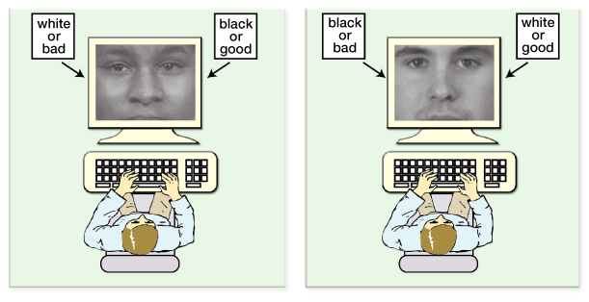
2007 HARVARD STUDY
Linking Racial Framing to Treatment
287 Boston and Atlanta physicians studied on the “connection between explicit and unconscious racial bias”
When asked questions, there was no overt bias for white patients however, when they took the “Implicit Association Test” the results were evidently biased.
https://implicit.harvard.edu/implicit/takeatest.html
Find out your implicit associations!

Slide 22
Importance of Listening to Patients and Physicians of Color
Researchers have found that white physicians who accept, consciously or unconsciously, the white frame’s old racial stereotypes are likely to communicate negative feelings in verbal or nonverbal treatment behavior, sometimes causing patients of color to withhold the health self-disclosure necessary for effective treatment.

Slide 23
How to Draw Conclusions from the Article
2 types of conclusions you can draw:
Based on what the author says.
Based on what you can piece together.
Key points you want to mention in your conclusion based on the authors notes
What does the author imply are the effects of the study discussed?
How does this study contribute to the knowledge present and push it further?
What can you conclude for sure? What information has loopholes?
Key points you want to mention based on your individual conclusion
What key points stand out to you?
How would you explain this article in a few sentences to someone who hasn't read it?
Does this article bring up any concerns?
Formulate the article into your own words and understanding

Slide 24
Conclusion from the authors notes and making it your own
Search for key sentences that summarize the authors point, and format it into simpler terms :
“We recognize that generations of white-imposed racism in other institutions including employment, housing, and education–have contributed greatly to racial inequalities in health.”
There a long history of racist institutes and practices that have shaped employment, housing and education which ultimately has lead to disparities in healthcare
This is the author's main argument throughout the article. You can take this further by giving a summary of the proposals for change the article suggests.
“Comprehensive research and other educational efforts to publicly voice experiences of people of color with institutionalized racism in health-related institutions–and their policy solutions–constitute one step.”
“Another educational effort should involve calling out and teaching about the commonplace racist framing and structured-in practices of white (and white-oriented) administrators and professionals who still mostly control historically white medical, public health, and research-funding institutions.”
“One goal would be an accent on aggressive enforcement of existing civil rights laws.”
One way to bring about change is by telling stories of those who have experienced unjust treatment in health care institutes and what solution came out of it
Another way is to hold these institutes where this ideology is allowed accountale. It is important to break down the way these institutes communicate ideas and the negative connotations these ideas bring in healthcare
Ensure laws that protect healthcare rights are enforced,. Ex. Title V of the 1964 Civil Rights Act

Slide 25
How to address any concerns the article may cause
Sometimes language in an article can be a viewed as controversial when discussing the main points of an article.
For example this article mentions the word “white” often. This can be perceived as being negative without giving proper context. It is a fact that many racist teachings stem from previously racist white institutes. By giving background and facts you can avoid any misunderstandings.
When forming your own conclusion from the article it is important to not stray away from facts. It is important to address what you are 100% sure of and what is in the process- example can be future testing.

Slide 26
Citation
Feagin, Joe, and Zinobia Bennefield. "Systemic racism and US health care." Social science & medicine 103 (2014): 7-14.

Slide 27
Group Discussion On Systemic Racism and U.S. Health Care
(don't hesitate to tell your experiences, ask any questions, and/or reflect on ideas!)
Link to Pre-Health Research Journal Club Presentation Form:
https://forms.gle/5wJCUdBbhHrye5j17

Slide 28
SUPPLEMENTARY DISCUSSION
Health Disparities: COVID-19 and LGBTQIA+
Overview:
Lessons Learned From Pandemics
CDC Statistical Analysis of COVID-19’s Effect on Populations
New LGBTQIA+ Healthcare Order

Slide 29
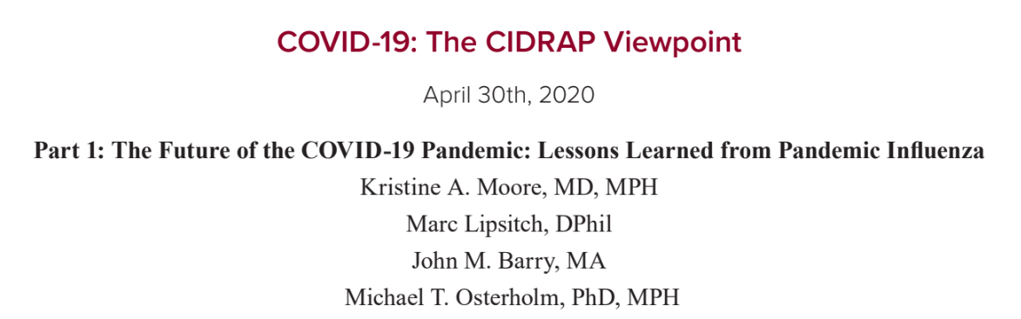

Why is COVID-19 so unpredictable?
The epidemiology of other serious coronaviruses (SARS-CoV-1, the virus that causes severe acute respiratory syndrome [SARS] and Middle East respiratory syndrome coronavirus [MERS-CoV]) is substantially different from that of SARS-CoV-2; therefore, these pathogens do not provide useful models for predicting what to expect with this pandemic.
Current Study:
Best comparative model is pandemic influenza. Since the early 1700s, at least eight global influenza pandemics have occurred.

Slide 30
SARS-CoV-2 vs. Pandemic Influenza Virus
Similarities:
Novel viral pathogens, resulting in worldwide susceptibility.
Spread via respiratory route; asymptomatic transmission
Public health officials stated the 25% of all COVID cases may be asymptomatic
Differences:
Incubation periods [influenza: range 1 to 4 days] [COVID-19: range 2 to 14 days]
One way to quantify the transmissibility of a virus is to determine the basic reproductive number (R0) for that virus. The R0 is the average number of new infections that result from a single infected person in a wholly susceptible population.
A higher R0 means more people will need to get infected and become immune before the pandemic can end.
Based on the most recent flu pandemics, this outbreak will likely last 18 to 24 months.
It likely won’t be halted until 60% to 70% of the population is immune.

Slide 31
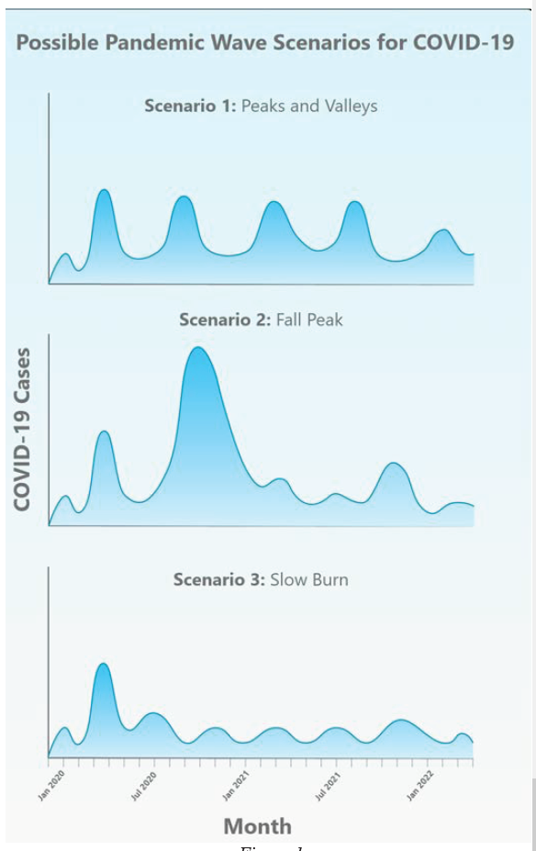

Slide 32
Citation
Moore, Kristine A., et al. "COVID‐19: The CIDRAP Viewpoint: Part 1: The Future of the COVID‐19 Pandemic: Lessons Learned from Pandemic Influenza." CIDRAP: University of Minnesota. April 30th (2020).

Slide 33
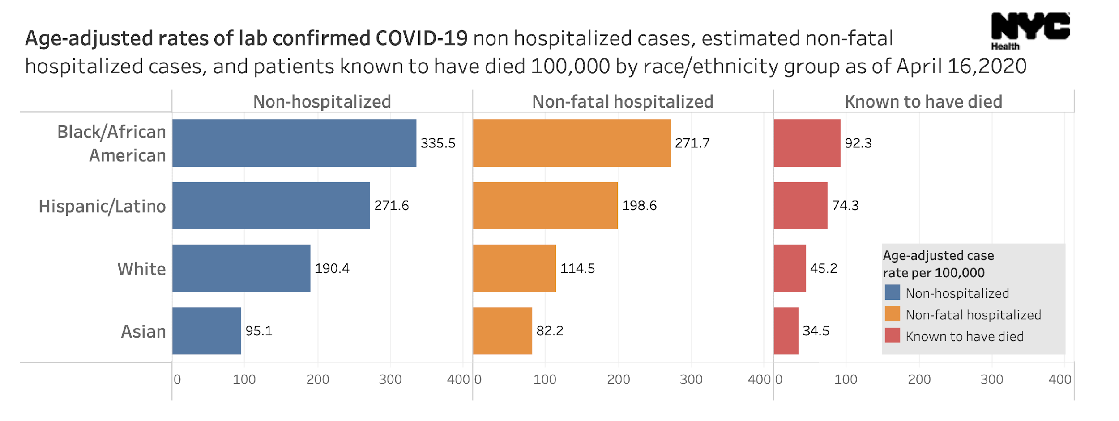

Slide 34

FACTORS THE INFLUENCE RACIAL AND MINORITY ETHNIC GROUP HEALTH SOURCE: CDC
Important to note that the factors below cause isolation for minorities
Living Conditions
By living in densely populated areas can have a harder time social distancing.
Residential Segregation- being further from medical and wellness facilities.
Families might live together, Multi-generational households, which tend to include elderly and younger children who are more prone,
Minorities are overrepresented in jails, prisons and detention centers .
Work Circumstances
Most of the essential workers come from minority households
Quarter of employed workers in service jobs are Hispanic, black or African American.
Hispanics make up 17% of the workforce but service 53% of agricultural workers.
African Americans or Blacks make up 12% of workers but comprise 30% of nurses.
There is a lack of paid sick leave which leaves these groups no choice but to work.

Slide 35
FACTORS THE INFLUENCE RACIAL AND MINORITY ETHNIC GROUP HEALTH SOURCE: CDC CONT.
3) Underlying health conditions and lower access to care
Not having health insurance
Hispanics are 3x more likely to be uninsured while African Americans are 2x more likely compared to whites
Other barriers that isolate these groups
Language
Distrust within the healthcare system
Financial implications
Medical conditions
Stigma
Systemic inequalities

Slide 36
WHAT CAN BE DONE?
Support partnerships between research and these communities
Make sure that information regarding COVID-19 is accurate, credible and accessible.
Give minority groups easier access to healthcare facilities when it comes to underlying medical conditions and language barriers.
Ensure that healthcare professionals and systems understand cultural differences in patients and how different patients interact with them.
Connect people with grocery delivering, temporary housing or healthcare providers/resources to help them with social distancing.
Promote a trusting relationship between healthcare professionals and patients by encouraging patients to call and ask questions.
Take precautions to protect not only yourself but the people you care about and your community.

Slide 37
Transgender Health Protections
The Trump administration finalized a rule that removes nondiscriminatory protections for the LGBTQ community
when it comes to healthcare.
This rule was laid out in section 1557 of the Affordable Care Act and it states that discrimination is prohibited on the basis of sex, age, race, nationality or disability in all healthcare facilities.
This means that healthcare workers could refuse care to a transgender person if their identity conflicted with the worker’s religious beliefs.

Slide 38
Discussion Question
Should healthcare workers have the right to refuse care to a patient on the basis of religious freedom?

Slide 39

Thank you!
Please direct any questions to:
hunterjournalclub@gmail.com
Follow Us for Updates!
@hunterjournalclub

